Slide 1
Unit-4
Network Layer

Slide 2
Transmission Control Protocol (TCP):
TCP is a transport layer protocol for process-to-process communication like UDP. It is a connection oriented, reliable transport protocol. TCP creates a virtual connection between two TCP clients to send data. In addition, TCP uses flow and error control mechanisms at the transport level.
TCP Operations:
Various services and operations of TCP are as follows:
Process to Process Communication: Like UDP, TCP provides process-to-process communication using port numbers.
Stream Delivery Service: TCP is a stream-oriented protocol. It allows the sending process to deliver data as a stream of bytes and allows the receiving process to obtain data as a stream of bytes. TCP creates an environment in which the two processes seem to have a dedicated connection that carries their data across the internet. For flow control, TCP uses sending and receiving buffer that provides some storage for data packets in case of overflow. This prevents the loss of packets by synchronizing the flow rate.

Slide 3
Full-Duplex Communication: TCP offers full-duplex services in which data can flow in both directions at the same time. Each TCP then has sending and receiving buffer, and segments move in both directions.
Connection-Oriented Service: When a process at site A wants to send and receive data from another process at site B, the following occurs:
• The two TCPs establish a connection between them.
• Data are exchanged in both directions.
• The connection is terminated.
Note that this a virtual connection, not a physical connection.
Reliable Service: TCP is a reliable transport protocol. It uses an acknowledgement mechanism to check the safe arrival of data. This is possible due to efficient error control mechanisms.

Slide 4
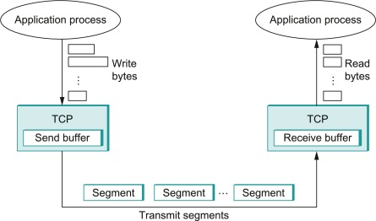
Transmit Segments

Slide 5
TCP Features and Characteristics:
To support the services of TCP, following are some features:
Numbering System: TCP keeps track of segments being transmitted or received. There are two fields called the sequence number and the acknowledgement number for numbering the bytes within the segments and acknowledgements respectively.
Flow control: TCP provides flow control mechanism. The receiver of the data controls the amount of data that are to be sent by the sender. This is done to prevent the receiver from being overloaded with data. The numbering system allows TCP to use a byte-oriented flow control.
Error Control: To provide reliable service, TCP implements an error control mechanism. Although error control mechanism considers a segment as the unit of data for error detection (loss or corrupted
segments), error control is byte-oriented.
Congestion Control: TCP takes into account about the congestion in the network. The amount of data sent by a sender is not only controlled by the receiver (flow control), but is also determined by the level of congestion in the network.

Slide 6
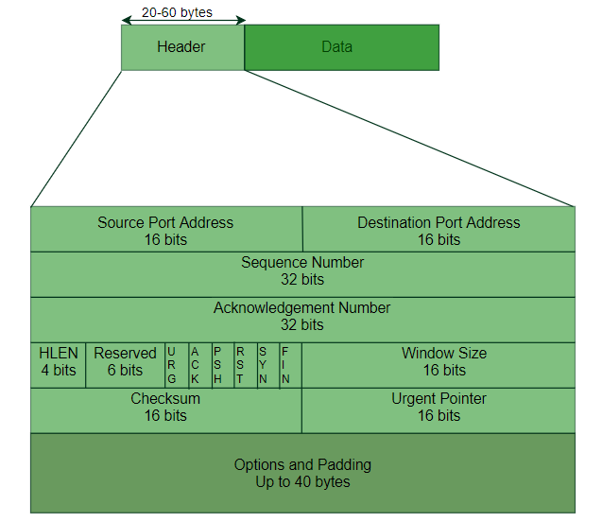
TCP Segment structure –
A TCP segment consists of data bytes to be sent and a header that is added to the data by TCP as shown:

Slide 7
The header of a TCP segment can range from 20-60 bytes. 40 bytes are for options. If there are no options, a header is 20 bytes else it can be of upmost 60 bytes.
Header fields:
Source Port Address – A 16-bit field that holds the port address of the application that is sending the data segment.
Destination Port Address – A 16-bit field that holds the port address of the application in the host that is receiving the data segment.
Sequence Number – A 32-bit field that holds the sequence number, i.e, the byte number of the first byte that is sent in that particular segment. It is used to reassemble the message at the receiving end of the segments that are received out of order.
Acknowledgement Number – A 32-bit field that holds the acknowledgement number, i.e, the byte number that the receiver expects to receive next. It is an acknowledgement for the previous bytes being received successfully.
Header Length (HLEN) –It specifies the length of the header which of 4 bit length.

Slide 8
Control flags – These are 6 1-bit control bits that control connection establishment, connection termination, connection abortion, flow control, mode of transfer etc. Their function is:
URG: Urgent pointer is valid
ACK: Acknowledgement number is valid( used in case of cumulative acknowledgement)
PSH: Request for push
RST: Reset the connection
SYN: Synchronize sequence numbers
FIN: Terminate the connection
Window size – This field tells the window size of the sending TCP in bytes.
Checksum – This field holds the checksum for error control. It is mandatory in TCP as opposed to UDP.
Urgent pointer – This field (valid only if the URG control flag is set) is used to point to data that is urgently required that needs to reach the receiving process at the earliest. The value of this field is added to the sequence number to get the byte number of the last urgent byte.

Slide 9
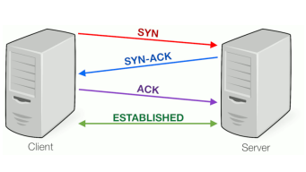
Three-Way Handshaking:
Since TCP is a connection-oriented service, it requires three phases: connection establishment, data
transfer, and connection termination.
The connection establishment in TCP is called three-way handshaking. The figure below shows the
handshaking process.
Similarly three way handshaking is also uesd for connection termination.

Slide 10
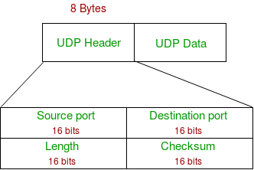
User Datagram Protocol (UDP):
The user datagram protocol (UDP) is called a connectionless, unreliable transport protocol. It does not add anything to the services of IP except to provide process-to-process communication instead of hostto-host communication.
The UDP packet structure is as follows:

Slide 11
Source Port: Source Port is a 2 Byte long field used to identify the port number of the source.
Destination Port: It is a 2 Byte long field, used to identify the port of the destined packet.
Length: Length is the length of UDP including the header and the data. It is a 16-bits field.
Checksum: Checksum is 2 Bytes long field. It is the 16-bit one’s complement of the one’s complement sum of the UDP header, the pseudo-header of information from the IP header, and the data, padded with zero octets at the end (if necessary) to make a multiple of two octets.

Slide 12
Applications of UDP:
Used for simple request-response communication when the size of data is less and hence there is lesser concern about flow and error control.
It is a suitable protocol for multicasting as UDP supports packet switching.
UDP is used for some routing update protocols like RIP(Routing Information Protocol).
Normally used for real-time applications which can not tolerate uneven delays between sections of a received message.
UDP is widely used in online gaming, where low latency and high-speed communication is essential for a good gaming experience. Game servers often send small, frequent packets of data to clients, and UDP is well suited for this type of communication as it is fast and lightweight.
Streaming media applications, such as IPTV, online radio, and video conferencing, use UDP to transmit real-time audio and video data. The loss of some packets can be tolerated in these applications, as the data is continuously flowing and does not require retransmission.

Slide 13
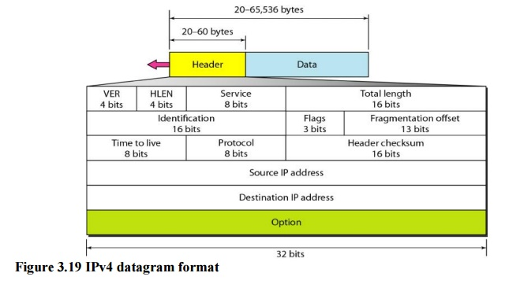
IPv4 Header Format:
20 - 65,535 bytes

Slide 14
Version number. These 4 bits specify the IP protocol version of the datagram. By looking at the version number, the router can determine how to interpret the remainder of the IP datagram. Different versions of IP use different datagram formats.
HL(Internet Header Length - 4 bits): The minimum value is 5, and the maximum is 15. The header length is necessary because IPv4 allows for variable-length options.
Type of Service (8 bits): Originally intended for Quality of Service (QoS) settings, it includes the Precedence, Delay, Throughput, Reliability, and Cost of Service fields. However, these are not widely used, and the field is often set to zero.
Total Length (16 bits): Specifies the total length of the IPv4 packet (header + data). The maximum value is 65,535 bytes.

Slide 15
Identification: If IP packet is fragmented during the transmission, all the fragmented contain same identification number to identify the original ip packet that belong too.
Flags: As required by the network resources, if ip packet is too large to handle,these flags tells if they can be fragmented or not.The first bit is reserved(not used).The second bit is called the do not fragment bit. If its value is 1, the machine must not fragment the datagram . If it cannot pass the datagram through any available physical network, it discards the datagram and sends an ICMP error message to the source host. If its value is 0, the datagram can be fragmented if necessary. The third bit is called the more fragment bit. If its value is 1, it means the datagram is not the last fragment . If its value is 0, it means this is the last or only fragment.

Slide 16
Flag bits
1st bit | Reserved (not used)
2nd bit | Called do not fragment bit. -if value 1 = the datagram must not fragmented -If value 0 = the datagram can be fragmented
3rd bit | Called more fragment bit. -if value 1 = means the datagram is not last fragment If value 0 = means this is last fragment.
Fragment offset: This offset tells the exact position of the fragment in the original Packet.
Time-to-live: Time-to-live. The time-to-live (TTL) field is included to ensure that datagrams do not circulate forever (due to, for example, a long-lived routing loop) in the network. This field is decremented by one each time the datagram is processed by a router. If the TTL field reaches 0, the datagram must be dropped.
Protocol. This field is used only when an IP datagram reaches its final destination. The value of this field indicates the specific transport-layer protocol to which the data portion of this IP datagram should be passed. For example, (e.g., TCP, UDP)
Header Checksum: This field is used to keep checksum value of entire header which is then used to check if the packet is received error-free.
Source address: This 32 bit field define the address of the sender.
Source address: This 32 bit field defines the address of the receiver.

Slide 17
Option:This is optional field , which is used if the value of IHL is greater than 5. this option may contain values for option such as security,record route,time stamp, etc.
Data(Payload): It is the last and important field. In most circumstances, the data field of the IP datagram contains the transport-layer segment (TCP and UDP) to be delivered to the destination. How ever the data can carry other type of data, such as ICMP message.
IPv4 issues: The major issues in IPv4 are
➢ Deficiency of address space - The devices connected to the Internet grows exponentially. The size of address space 2^32 is quickly exhausted;
➢ Too large routing tables

Slide 18
IPv6 address: An Ipv6 made of 128 bits divided into eight 16 bits segment or block.
Ex: FDEC : BA98 : 0000 : 0000 : 0600 : BDFF : 0004 : FFFF
All IPv6 addresses are 128-bit hexadecimal addresses, written in 8 separate sections having each of them have 16 bits. As the IPv6 addresses are represented in a hexadecimal format, their sections range from 0 to FFFF. Each section is separated by colons (:). It also allows to removes the starting zeros (0) of each 16-bit section. If two or more consecutive sections 16-bit contains all zeros (0 : 0), they can be compressed using double colons (::).

Slide 19
IPv6 addresses are consist of 8 different sections, each section has a 16-bit hexadecimal values separated by colon (:). IPv6 addresses are represented as following format:
xxxx : xxxx : xxxx : xxxx : xxxx : xxxx : xxxx : xxxx
Each "xxxx" group contains a 16-bit hexadecimal value, and each "x" is a 4-bit hexadecimal value. For example:
FDEC : BA98 : 0000 : 0000 : 0600 : BDFF : 0004 : FFFF
You can also remove the starting zeros (0) of each 16-bit section. For example, the above IPv6 can be rewritten by omitting starting zeros (0) as follow:
FDEC : BA98 : 0 : 0 : 600 : BDFF : 4 : FFFF
You can also compress the consecutive sections 16-bit zeros (0 : 0) using double colons (::). But keep in mind that you can do it only once per IP address.
FDEC : BA98 : : 600 : BDFF : 4 : FFFF

Slide 20
Features of IPV6:
Larger address space: Approx 2^128.
Simplified Header: It is simplified by moving all unnecessary information and option to the end of the ipv6 header. Header size is 40 bytes.
End-to-end connectivity: no need of NAT
Auto Configuration: Ipv6 supports both stateful and stateless auto configuration mode of its host device.
Fast forwarding/Routing: simplified header puts all unnecessary information at the end of the header. Only important information is available at the front thus making routing decision is quickly.
Ipsec: Initially it was decided that IPV6 must have IpSec security, making it more secure than IPv4.This feature has now made optional.
Anycast:In this mode , multiple interface over the internet are assigned the same anycast Ip address. Router while routing send the packet to the nearest destination.
Mobility: Ipv6 was designed keeping mobility in mind. This feature enables hosts (such as mobile phone) to roam around in different geographical area and remain connected with same Ip address .

Slide 21
IPV6 Datagaram Formats
Ipv6 has 4 times larger than IPV4, but the header of an ipv6 is only 2 times larger than that of ipv4.Ipv6 header have one fixed header and zero or more optional(extensoin) headers.All the necessary information that is essential for a router is kept in the fixed header.The extension header contains optional information that helps routers to understand how to handle a packet flow.
IPV6 Header | Extension Header | Upper Layer Protocol Data
Main information
Other optional infromation
Upper layer protocol(TCP,UDP,ICMP)

Slide 22
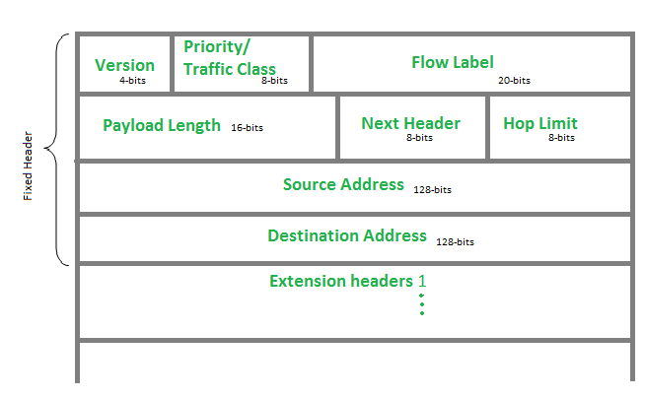

Slide 23
Version (4-bits): It represents the version of Internet Protocol, i.e. 0110
Traffic Class (8-bits)(audio,video) These 8 bits are divided into two parts. The most significant 6 bits are used for Type of Service to let the Router know what services should be provided to this packet. The least significant 2 bits are used for Congestion Notification (ECN).
Flow Label (20-bits): This label is used to maintain the sequential flow of the packets belonging to a communication. The source labels the sequence to help the router identify that a particular packet belongs to a specific flow of information.
Payload Length (16-bits): This field is used to tell the routers how much information a particular packet contains in its payload. Payload is composed of Extension Headers and Upper Layer data.
Next Header (8-bits): This field identifies the protocol to which the contents of this datagram will be delivered for ex: TCP or UDP. This field uses the same values as the protocol field in the IPv4 header.
Hop Limit (8-bits): This field is used to stop packet to loop in the network infinitely. This is same as TTL in IPv4. The value of Hop Limit field is decremented by 1 as it passes a link (router/hop). When the field reaches 0, the packet is discarded.
Source Address (128-bits): This field indicates the address of originator of the packet.
Destination Address (128-bits): This field provides the address of intended recipient of the packet.

Slide 24
IPv6 has three address categories:
Unicast - identifies exactly one interface
Multicast - identifies a group; packets get delivered to all members of the group
Anycast - identifies a group; packets normally get delivered to nearest member of the group

Slide 25
Transition from IPv4 to IPv6:
Because of the huge number of systems on the internet, the transition from IPv4 to IPv6 cannot happen suddenly. The transition must be smooth to prevent any problems between IPv4 and IPv6 systems. Three strategies have been devised to help the transition:
Dual stack
Tunneling
Header translation
Dual Stack:
Dual-stack transition mechanism enables to run both IP stacks (IPv4 and IPv6) in a single node. Maintainsboth IP protocol stacks that operates parallel and thus allow the end node to use either protocols. Nodeis capable of handling both kinds of IP (IPv4&IPv6) routing. Flow or routing decisions in the node arebasedon IP header version’s field. Both IPv4 and IPv6 shares common transport layer protocols such as TCP/IP. Many of client and server operating systems provide dual IP protocol stacks. For example: Windows 7, 8, Linux

Slide 26
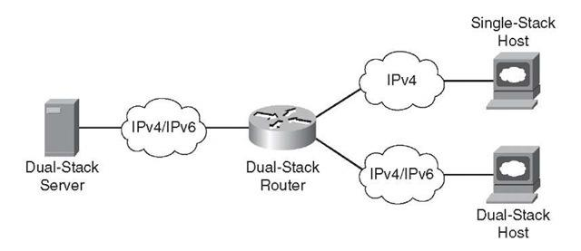
The Dual Stack Router, can communicate with both the networks. It provides a medium for the hosts to access a server without changing their respective IP versions

Slide 27
Tunneling:
Tunneling is a strategy used when two computers using IPv4 want to communicate with each other and the packet must pass through a region that uses IPv6. To pass through this region, the packet must have IPv6 address. So the IPv4 packet is encapsulated in an IPv6 packet when it enters the region, and it leaves its capsule when it exits the region. Seems as if the IPv4 packet goes through a tunnel at one end and emerges at the other end.

Slide 28
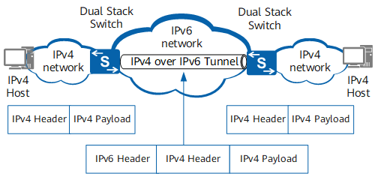

Slide 29
Header Translation:
Translation mechanism refers the direct conversion of IP protocols. May include transformation of both IPv4 and IPv6 protocol’s header and payload according to their IP specifications. Translation mechanisms always need translators that can translate particular IPv4 address to particular IPv6 address and vice versa. A host with IPv4 address sends a request to an IPv6 enabled server on Internet that does not understandIPv4 address. In this scenario, the NAT device can help them communicate. When the IPv4 host sends a request packet to the IPv6 server, the NAT device/router strips down the IPv4 packet, removes IPv4header, and adds IPv6 header and passes it through the Internet. When a response from the IPv6servercomes for the IPv4 host, the router does vice versa.

Slide 30
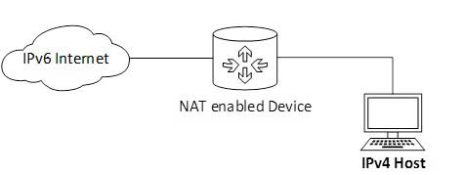

Slide 31
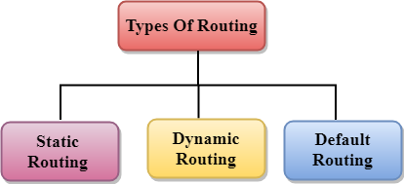
Routing:
Routing is a process that is performed by layer 3 (or network layer) devices in order to deliver the packet by choosing an optimal path from one network to another.

Slide 32
1. Static Routing
Static routing is a process in which we have to manually add routes to the routing table.
Advantages
No routing overhead for the router CPU which means a cheaper router can be used to do routing.
It adds security because only an only administrator can allow routing to particular networks only.
No bandwidth usage between routers.
Disadvantage
For a large network, it is a hectic task for administrators to manually add each route for the network in the routing table on each router.
The administrator should have good knowledge of the topology. If a new administrator comes, then he has to manually add each route so he should have very good knowledge of the routes of the topology.

Slide 33
Default Routing
Default Routing is a technique in which a router is configured to send all the packets to the same hop device, and it doesn't matter whether it belongs to a particular network or not. A Packet is transmitted to the device for which it is configured in default routing.
Default Routing is used when networks deal with the single exit point.
It is also useful when the bulk of transmission networks have to transmit the data to the same hop device.
When a specific route is mentioned in the routing table, the router will choose the specific route rather than the default route. The default route is chosen only when a specific route is not mentioned in the routing table.

Slide 34
Dynamic Routing
It is also known as Adaptive Routing.
It is a technique in which a router adds a new route in the routing table for each packet in response to the changes in the condition or topology of the network.
Dynamic protocols are used to discover the new routes to reach the destination.
In Dynamic Routing, RIP and OSPF are the protocols used to discover the new routes.
If any route goes down, then the automatic adjustment will be made to reach the destination.

Slide 35
The Dynamic protocol should have the following features:
All the routers must have the same dynamic routing protocol in order to exchange the routes.
If the router discovers any change in the condition or topology, then router broadcast this information to all other routers.
Advantages of Dynamic Routing:
It is easier to configure.
It is more effective in selecting the best route in response to the changes in the condition or topology.
Disadvantages of Dynamic Routing:
It is more expensive in terms of CPU and bandwidth usage.
It is less secure as compared to default and static routing.

Slide 36
S.NO | Static Routing | Dynamic Routing
1. | In static routing routes are user-defined. | In dynamic routing, routes are updated according to the topology.
2. | Static routing does not use complex routing algorithms. | Dynamic routing uses complex routing algorithms.
3. | Static routing provides high or more security. | Dynamic routing provides less security.
4. | Static routing is manual. | Dynamic routing is automated.
5. | Static routing is implemented in small networks. | Dynamic routing is implemented in large networks.
6. | In static routing, additional resources are not required. | In dynamic routing, additional resources are required.

Slide 37
7. | In static routing, failure of the link disrupts the rerouting. | In dynamic routing, failure of the link does not interrupt the rerouting.
8. | Less Bandwidth is required in Static Routing. | More Bandwidth is required in Dynamic Routing.
9. | Static Routing is difficult to configure. | Static Routing is easy to configure.
10. | Another name for static routing is non-adaptive routing. | Another name for dynamic routing is adaptive routing.

Slide 38
Dynamic Routing
Interior Gateway Protocol
Exterior Gateway Protocol
Distance Vector Routing protocol
Link State Routing Protocol
Path Vector Routing Protocol
RIP
OSPF
BGP

Slide 39
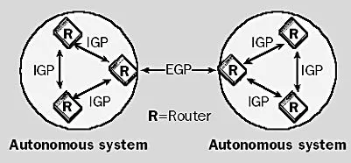
IGP:
IGP, or Interior Gateway Protocol, is a type of routing protocol used for distributing routing information within autonomous systems in large internetworks based on the TCP/IP protocol.
Routers use IGP when exchanging Internet Protocol data. A single adjustable formula combines for route comparison and creates IGP metrics.
The two IGP types are: .

Slide 40
1 Distance Vector routing protocol Protocol:
It is a dynamic routing algorithm in which each router computes distance between itself and each possible destination i.e. its immediate neighbors.
The router shares its knowledge about the whole network to its neighbors and accordingly updates table based on its neighbors.
The sharing of information with the neighbors takes place at regular intervals. It makes use if Bellman Ford Algorithm for making routing tables.
The vector shows the direction to the specific network.
Distance vector protocols send their entire routing table to directly connected neighbors.
Example of distance vector protocols include RIP and IGRP

Slide 41
Routing Information Protocol (RIP):
It is a dynamic routing protocol that uses hop count as a routing metric to find the best path between the source and the destination network. It is a distance-vector routing on the Network layer of the OSI model. RIP uses port number 520.
Hop Count
Hop count is the number of routers occurring in between the source and destination network. The path with the lowest hop count is considered as the best route to reach a network and therefore placed in the routing table. RIP prevents routing loops by limiting the number of hops allowed in a path from source and destination. The maximum hop count allowed for RIP is 15 and a hop count of 16 is considered as network unreachable.

Slide 42
Advantages of RIP
It is easy to configure.
that it does not require an update every time the topology of network changes.
Guaranteed to support almost all routers
Disadvantages of RIP
RIP is a class full routing protocol and it does not support VLSM.
It Broadcast the update to the entire network and simply creates a lots of traffic.
RIP supports maximum 15 hops(0-15) ,means maximum 16 routers can be configured in RIP not more than that.
It is only based on hop count. So, if there is a better route available with better bandwidth then it will not select that route.

Slide 43
Link State Protocols:
It is a dynamic routing protocol in which each router shares knowledge of its neighbors with every other router in the network. A router sends its information about its neighbors only to all the routers through flooding. Information sharing takes place only whenever there is a change. It makes use of Dijkastra’s Algorithm for making routing tables. Link state protocols are also called shortest-path-first protocols. Links state routing protocols have a complete picture of the network topology. Hence they know more about the whole network than any distance vector protocol.
Three separate tables are created on each link state routing enabled router.
One table is used to hold details about directly connected neighbors.
One is used to hold the topology of the entire internetwork
Last one is used to hold the actual routing table.
Example OSPF

Slide 44
Distance vector Routing | Link State Routing
Bandwidth require is less due to local sharing | Bandwidth require is more due to flooding and sending of large link state packet
Based on local knowledge since updates table based on information from neighbors. | Based on global knowledge i.e. it have knowledge about entire network.
Make use of Bellman ford algorithm | Dijkastra’s algorithm
Traffic is less | Traffic is more
Count to infinity problem | No count to infinity problem
Practical implementation is RIP | Practical implementation is OSPF
Configuration of distance vector is easy | Configuration for link state routing is difficult
Utilization of memory and cpu in distance vector routing is lower than Link state. | Utilization of CPU and memory in link state routing is faster than distance vector.

Slide 45
OSPF Protocol
Open Shortest Path First (OSPF) is a link-state routing protocol which is used to find the best path between the source and the destination routing using its own shortest path first. OSPF is developed by internet Engineering Task force as one of the interior ggateway protocol (IGP). The protocol which aims at moving the packet within a large autonomous system or routing domain.
OSPF uses multicast address 224.0.0.5 for normal communication and 224.0.0.6 for update to desiginated router(DR)/Backup designated Router (BDR).
OSPF Terms:
1. Router id: it is the highest active IP address present on the router. First, highest looback address is considered. If no loopback is configured then the hghest active IP address on the interface of the router is considered.
2. Router priority: It is an 8 bit value assigned to arouter operating OSPF,used to elect DR and BDR in a broadcst network.

Slide 46
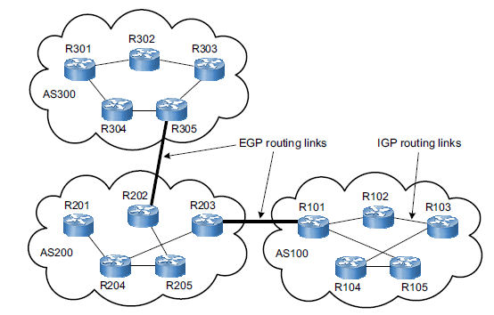
3. Designated Router: It is elected to minimize the number of adjacency formed. DR distributes the LSA’s to all the other routers.
4. Backup Designated Router(BDR):BDR is backup to DR in a broadcast network. When DR goes down, BDR becomes DR and perform its function.

Slide 47
Types of links in OSPF
A link is basically a connection, so the connection between two routers is known as a link.
There are four types of links in OSPF:
Point-to-point link: The point-to-point link directly connects the two routers without any host or router in between.
Transient link: When several routers are attached in a network, they are known as a transient link. Stub link: It is a network that is connected to the single router. Data enters to the network through the single router and leaves the network through the same router.
Virtual link: If the link between the two routers is broken, the administration creates the virtual path between the routers, and that path could be a long one also.

Slide 48
Border Gateway Protocol (BGP)
It is an Exterior Gateway Routing Protocol.
IT is used to Exchange routing information for the internet and is the protocol used between ISP which are different ASes.
The main role of BGP is to provide communication between two autonomous systems.
BGP advertisement also include path information,

Slide 49
Multicasting:
The most common type of messgae in a network is the transmission between two computers. one computer sends message to anther computer( e.g. a client requesting a WEB page). This is called a Unicast essage. Typically , an Ip address refers to an individual hosts on a pparticular network. IP accomodates addresses that referes to a group of hosts on one or more networks. Such address refferred to as multicast address, and the act of sendind a packet from a source to the members o a multicast group is referred to as multicasting. Computer wishing to participates in a multicast send amessage to the sending computer or some other computer performing routing alonng the way using a special type of packet called Internt Group management Protocol (IGMP).
Multicasting having number of practical aplication.
1. multimedia: A number of user “tune in” to a video or audio transmission from a multimedia source station.
2.Teleconferencing : A group of workstation frmo a multicast groupsuch that transmission from any member is received by all other group members.

Slide 50
Anatomy of Router
A Router is a networking device that fulfills the need for devices to share files and forward data packets between devices over computer networks. Routers perform some directing functions on the Internet so the data sent over the internet, such as a web page in the form of data packets.
A generic router consists of the following components:
Input Port: This is the interface by which packets are admitted into the router, it performs several key functions as terminating the physical link at the router
Switching Fabric: This is the main component of the Router, it connects the input ports with the output ports. It is kind of a network inside a networking device.
Output Ports: This is the segment from which packets are transmitted out of the router. The output port looks at its queuing buffers (when more than one packets have to be transmitted through the same output port queuing buffers are formed) and takes packets
Routing Processor: It executes the routing protocols, and works like a traditional CPU. It uses various routing algorithms like link-state algorithm, distance-vector algorithm, etc.

Slide 51
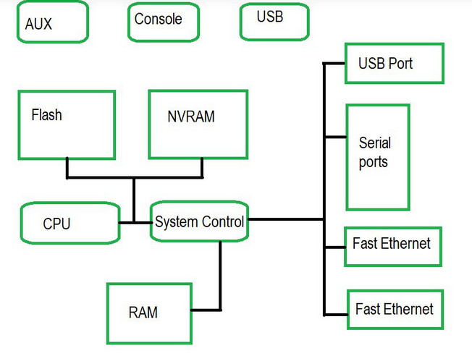
The Internal Components of Router:
Below is the raw diagram showing the internal components of the router:

Slide 52
CPU: The CPU in the router executes the commands and processes the commands in the operating system. The flow of data on the interface is controlled by the CPU.
ROM: Read Only Memory in the router mainly works when the router boots up or is powered up. It stores the bootstrap program needed when the router is turned on.
RAM: Random Access Memory in the router contains the executable file and running file of the configuration file and the contents are lost when the router’s power is turned off.
Flash Memory: It contains the operating system. The data of the flash memory remain unchanged when the router is rebooted or powered off. So, whenever the router is powered on the OS is loaded into RAM from flash memory.
NVRAM: It stands for Nonvolatile RAM. It is a backup copy of the running configuration file. Its functioning basically helps when the router loses power and the router needs to establish the configuration and load it again. The content of NVRAM is changeable. When the router is powered on it searches the startup-config file in NVRAM only.
Interfaces / Ports: If we want to connect the router with wire or we want a wired connection there are multiple interfaces that are used to connect the network. i.e. Fast Ethernet, Gigabit Ethernet, and Serial.

Slide 53
Known Address
In computer networks, a "known address" typically refers to a specific and predetermined identifier assigned to a network device or a network resource. There are two common contexts in which the term "known address" is used:
MAC Address (Media Access Control Address): Every network interface card (NIC) or network adapter in a device is assigned a unique hardware address known as the MAC address. This address is used to identify the device on a local network. MAC addresses are considered "known addresses" because they are assigned by the manufacturer and are typically hard-coded into the network interface.
IP Address (Internet Protocol Address): An IP address is a numerical label assigned to each device participating in a computer network that uses the Internet Protocol for communication. In certain contexts, a specific IP address may be referred to as a "known address" when it is assigned statically (manually configured) or obtained through dynamic means (such as DHCP) and is consistently associated with a specific device on the network.
In both cases, "known addresses" are used for communication and identification purposes within a network.

Slide 54
unknown address
An "unknown address" in the context of computer networking typically refers to an address that has not been assigned or identified within the network. There are two common scenarios where the term "unknown address" may apply:
Unassigned IP Address: In the case of dynamic addressing using protocols like DHCP (Dynamic Host Configuration Protocol), devices on a network may obtain their IP addresses dynamically from a DHCP server. If a device has not yet received an IP address from the DHCP server, or if it's not configured with a static IP address, its IP address is considered unknown until it acquires one.
Unrecognized MAC Address: When a device communicates on a local network, it uses its MAC address to identify itself. If a device with an unrecognized MAC address appears on the network, it may be considered an unknown address until its identity is determined. This situation could arise if a new device is introduced to the network, or if there are issues with the network configuration.

